Slide 1
Web Accessibility
These slides are modified from slides taken from www.csuci.edu by Peter Mosinskis

Slide 2
Overview
The User Experience
Makeover techniques to fix Web Accessibility issues
Accessibility checking
Useful links

Slide 3
The User Experience
“Keeping Web Accessibility In Mind”
Video available online at: www.webaim.org

Slide 4
Types of Disabilities
Visual (blindness, low vision, color- blindness)
Hearing (deafness, hard of hearing)
Physical/Motor (weakness, muscle control, paralysis)
Cognitive/Neurological (dyslexia, intellectual or memory impairments)
Multiple Disabilities (deaf and blind)

Slide 5
Some scenarios
online shopper with color blindness
reporter with repetitive stress injury
online student who is deaf
accountant with blindness
classroom student with dyslexia
retiree with aging-related conditions, managing personal finances
supermarket assistant with cognitive disability
teenager with deaf-blindness, seeking entertainment

Slide 6
What do these means to designers?
Disability accommodations must be provided quickly and as needed
Technology, web sites and any electronic documents must be accessible
from their inception, not ad hoc

Slide 7
Benefits
Scalability: do it once rather than coordinating accommodations each and every time
Reduces cost for retrofitting
Greater return on investment: non-disabled students will benefit from universal design
Universal Design = Access for All
Multiple means of access to information
Way to reach “digital generation”
Manage Risk (the reactive model often does not result in timely or “as effective as” access)

Slide 8
Accessibility
Most Frequent Checkpoints

Slide 9
(1) Text description of non-text elements
First determine if each image is meaningful or decorative
If image is meaningful
Write short description (7 to 80 characters long)
Add ALT attribute & description to <img> element
If necessary, add long description using LONGDESC attribute
If image is decorative:
Add “empty” ALT attribute of <img> element

Slide 10
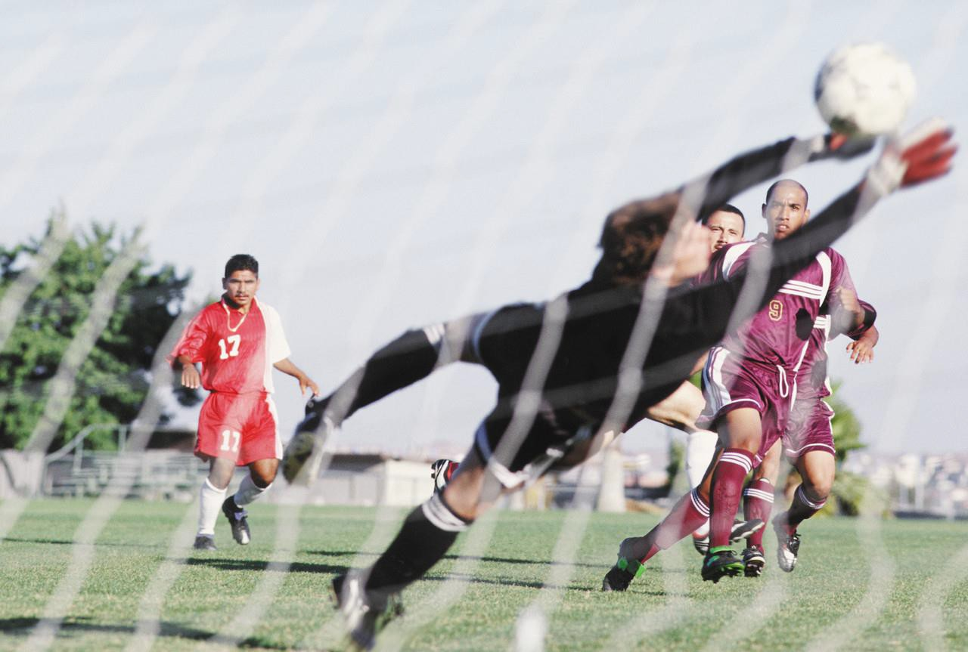
Example Image #1 (meaningful)

Slide 11
HTML Code for Example Image #1
WRONG:
<img src=“soccer.jpg” />
WRONG:
<img alt=“A baked potato” src=“soccer.jpg” />
RIGHT:
<img alt=“Soccer goalie leaping for ball” src=“soccer.jpg” />

Slide 12

Example Image #2 (decorative)

Slide 13
HTML Code for Example Image #2
WRONG:
<img src=“soccer.jpg” />
WRONG:
<img alt=“Hands on soccer ball” src=“soccer.jpg”
/>
RIGHT:
<img alt=“” src=“soccer.jpg” />

Slide 14
Using LONGDESC
What LONGDESC is
An attribute of the <img> element
When to use it
When you need 80+ characters or more to describe an image
Probably <5% of all images
How it’s used
<img alt=“My short description”
longdesc=“URL to my description” />

Slide 15

Example Image #3

Slide 16
HTML Code for Example Image #3
WRONG:
<img src=“cellstructures.jpg” />
WRONG:
<img alt=“Hands on soccer ball” src=“cellstructures.jpg”
/>
RIGHT:
<img alt=“Beta-secretase enzyme” longdesc=“http://www.csuci.edu/cs-description.htm” src=“cellstructures.jpg” />

Slide 17
Also Applies to Video and Audio
Video clips must be captioned
Audio-only clips require a text transcript
Audio-only clips don’t have to be captioned (they are not multimedia)

Slide 18
(2) Content can be conveyed without color
Two main issues
Use of color words
Color contrast of foreground/background colors

Slide 19
Issue #1 Color Words
Never depend on color alone: you can use color, but not to define sole source of information or meaning
WRONG:
“Items marked in red must be completed”
“Push the green button to start”
CORRECT:
“Items marked with * must be completed”
“Push the button titled “Start” to begin”

Slide 20
Issue #1 Color Words
Need to add emphasis?
Use <strong> or <em> to add emphasis instead of color
Can I still use color?
Yes, good use of color = good design

Slide 21
Issue #2 Contrast
Check contrast of text and background colors
Desktop tool: Colour Contrast Analyzer
Web based: http://juicystudio.com/services/colourcontrast. php
Highest contrast color scheme?
Black Text, White background!

Slide 22
(3) Document should be readable without style sheet
Check #1 (Firefox):
Web Developer Toolbar >
CSS button > Disable Styles > All Styles
Check #1 (Internet Explorer):
Use Web Accessibility Toolbar for IE 2.0 http://www.paciellogroup.com/resources/wat-ie-about.html

Slide 23
Document should be readable without style sheet
Check #1 (Firefox):
Web Developer Toolbar > Information button > View Document Outline
Page sections should be displayed in an organized, outlined form

Slide 24
Document should be readable without style sheet
Why is HTML structure important?
Screen reader software reads a page based on the HTML structure, NOT on the visual organization of page content
Checkpoints:
Can the page still be read?
Can the page still be navigated?
Is the organization of the page still clear and easily comprehensible?

Slide 25
Guidelines for Repair
Use HTML only for structure your content (not to apply formatting)
Structure your content using headings (<h1>) paragraphs (<p>), lists (<ol>, <ul>, and <li>) and tables
Use Cascading Style Sheets (CSS) to apply formatting and set the look of your page
Do not use HTML elements for purposes other than what they were intended (Example: use
<blockquote> only for quotes, not to indent)

Slide 26
(4)Make tables accessible
Two common table types
Layout tables
Invisible
Used to design layout for (older) web pages
Data tables
Used to display a set of data in columns & rows
Accessibility guidelines apply only to data tables
Check and repair: 4 steps

Slide 27
Sample Table Code
<table border="1" summary="Lists names and favorite colors">
<thead>
<tr>
<th scope="col">Name</th>
<th scope="col">Favorite Color</th>
6. </tr>
</thead>
<tbody>
<tr>
<td>Pat Smith</td>
<td>Red</td>
12. </tr>
<tr>
<td>Tyler Zipper</td>
<td>Green</td>
16. </tr>
</tbody>
</table>

Slide 28
Fixing tables – Step 1
First, remove non-table data from the table

Slide 29
Fixing tables – Step 2
The CAPTION element can be used to associate a title with the table
<caption>Computer Science Job Openings
- November 2011</caption>

Slide 30
Fixing tables – Step 3
Add a table summary using “summary”
attribute
Provides a textual description of the table
Example:
<table summary=“List of names and favorite colors”>

Slide 31
Fixing tables – Step 4
Use <th> (table heading) tags for column and row headings
First data table row should always contain
<th> tags
Example:
<th scope=“col”>Name</th>

Slide 32
(5) Applets, plug-ins and external content – Step 1
Make your PDF, Word, Excel, PowerPoint, etc. accessible
Similar accessibility techniques apply to these file formats
Provide links to the software used to view/read the document

Slide 33
(6) Skip Navigation Links
Each page must have a link that enables a user to jump to the main body content of a page
Enables skipping of repetitive navigation links

Slide 34
How to Fix:
1. Directly after <body> tag, add the following HTML:
<div id="skip">
<a href=“#back_to_top” name="back_to_top" id="back_to_top"></a>
<a href="#skip_navigation"><img
src=“http://www.csuci.edu/images/spacer.gif" width="1" height="1" border="0" alt="Skip Global Navigation"></a>
</div>

Slide 35
How to Fix:
2. At the start of the actual page body content, add the following HTML code:
<a name="skip_navigation” id="skip_navigation">
</a>

Slide 36
Accesibility
Less Frequent Checkpoints
…but no less important…

Slide 37
(1) Multimedia presentation alternatives and synchronization
Captioning must be done in real-time
Captioning must be synchronized with presentation (not a transcript provided later)
Webcasts require real-time captioning
How to Check:
Manual check required
How to Fix
Captioning Software (MAGPie; HiCaption)

Slide 38
(2) Eliminate screen flicker
Bad examples: http://www.hosanna1.com/
People with photosensitive epilepsy can have seizures triggered by flickering or flashing
Some people with cognitive or visual disabilities can’t read moving text
Moving text or images can be distracting
How to fix:
Remove blinking or flashing elements on a web page
Remove banner text that automatically scrolls
Remove animated GIFs – they are a nuisance

Slide 39
(3) Text-only page
If accessibility can’t be accomplished in any other way, text-only page is a possible alternative
Fact: There are virtually no instances (98%+) where this should be necessary
Fact: Text-only page by itself does not address accessibility (for example, what happens to content structure?)

Slide 40
Text-only page (continued)
Caveats to text-only page:
Text-only page must be updated whenever primary page changes
Text-only page must have equivalent information and functionality
How to Fix
Design (or redesign) carefully with accessibility in mind, not as an afterthought

Slide 41
(4) Accessible Forms
Information, field elements, and functionality of HTML forms must be accessible, including directions & cues
Users should be able to complete and submit the form using assistive technology

Slide 42
Accessible Forms
Form elements which need to be accessible
Push buttons
<INPUT type="button“> or <INPUT type="submit“>
Image buttons
<INPUT type="image"> and <BUTTON>
Text entry fields
<INPUT type="text"> and <TEXTAREA>
Radio buttons <INPUT type="radio">
Check boxes <INPUT type="checkbox">
Select (drop-down or list) menus <SELECT>

Slide 43
Accessible Forms
Push buttons: add “value” attribute
<input type="submit" value=“Submit This Form">
Image buttons: add “alt” attribute
<input type="image" name="Go" src="go.gif"
alt="Go">
Text Entry Fields:
Add “id” attribute and value to <input> tag
Add <label> tag before a text field
Add “for” attribute and value to <label> tag; set to “id”
value of <input> tag
Example:
<label for=“firstname”>First Name:</label><input type="text" id=“firstname” name=“fn" size=20>

Slide 44
Accessible Forms
Radio buttons & Check Boxes
Add <label> right after <input> tag
Example:
<input type=“radio“ id=“age01” value=“Under 40”><label for=“age01”>Under 40</label>

Slide 45
Accessible Forms
Select menus
Add <label> right before <select> tag
Example:
<label for=“favcolor”>Favorite Color</label>
<select title=“Choose Your Favorite Color” name=“favoritecolor” id=“favcolor”>
<option value=“”>Please select one</option>
<option value=“”>Blue</option>
<option value=“”>Red</option>
</select>

Slide 46
Accessible Forms
How to Check
Can you navigate the form using your keyboard?
Tips for Accessible Forms
Use <label> tag when possible
Add “title” attribute to <input>, <select>, and <textarea> tags
Use <fieldset> to group sets of form elements
Use <legend> to provide information on form elements
Use <optgroup> to group items in <select> lists
General Tips for Enhancing Web Forms
Using <label> tags you can move around where labels are placed (e.g., label in one cell of table, form field in another)
Apply style to forms using CSS

Slide 47
Accessibility
Least Frequent Checkpoints
…but still required…

Slide 48
(1) Image Maps
Image maps let you create clickable, linked areas on an portion of an image in a web page
You must provide links in your HTML code to all linked map areas for all server-side image maps
Use client-side image maps instead of server-side image maps

Slide 49
Image Maps
How to Fix:
Don’t use Server Side image maps (they are deprecated).
Reconfigure Server Side image maps as client-side image maps
Use ALT text on your image map link areas

Slide 50
Scripts and functional text
Any JavaScript should have “functional text”
“Functional text” is text that identifies what will happen when a script is activated.
How to Test:
Test JavaScript events without a mouse (keyboard only)
Test your site on a screen reader or talking browser
Turn JavaScript off, test all elements on page being affected by JavaScript to ensure no information is lost

Slide 51
Timed Response
When a timed response is required, the user shall be alerted and given sufficient time to indicate more time is required.
How to check:
Manual check - does your page require a timed response to a form?
How to fix:
Your web application must have an alerting mechanism so users can request more time

Slide 52
Now, Check your work
No tool can test all Web standards automatically
A list of tools available at: http://www.w3.org/WAI/RC/tools/complete
Verification requires use of automated checkers, assistive technology and manual checks
First run an automated checking tool and fix any errors identified in reports
Listen with assistive technology to ensure the site is accessible and usable
Logon pages, templates, navigation
Pages with data tables, forms and multimedia
Verify keyboard access
F6 to frames
Tab to links and controls (e.g. form input fields)
JavaScript keyboard access
Additional manual checks for some standards
JavaScript
Color
Multimedia

Slide 53
Always ask yourself:
Can all information be accessed by every user?
Can all information be searchable? and:
Have I added necessary comments?

Slide 54
Useful links
WCAG Standards - http://www.w3.org/TR/WAI- WEBCONTENT/
Web Standards Project: http://www.webstandards.org/learn/
WebAIM - http://www.webaim.org/

